Slide 1
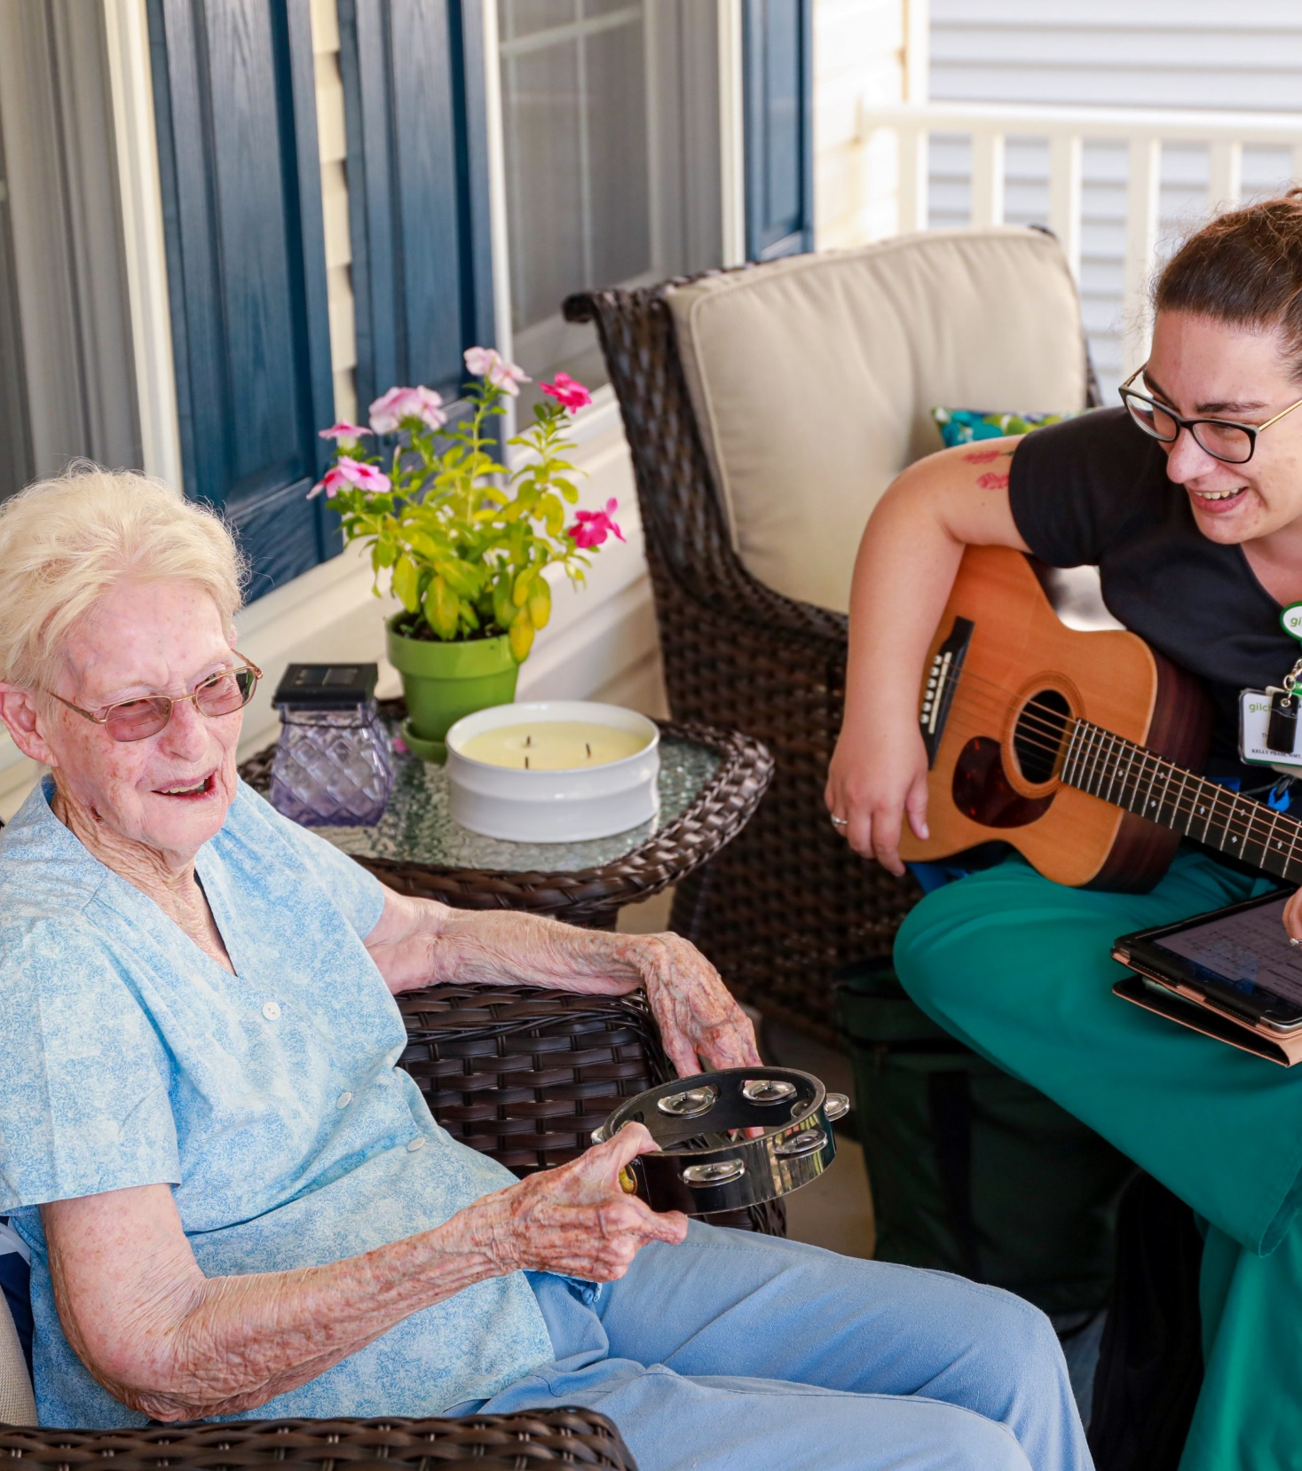
The Wonders of Gilchrist:
End of Life Decisions and Hospice Care
Rachel Weitzner, LCSW-C
Associate Director, Jewish Care & Support Program and Social Work Services

Slide 2



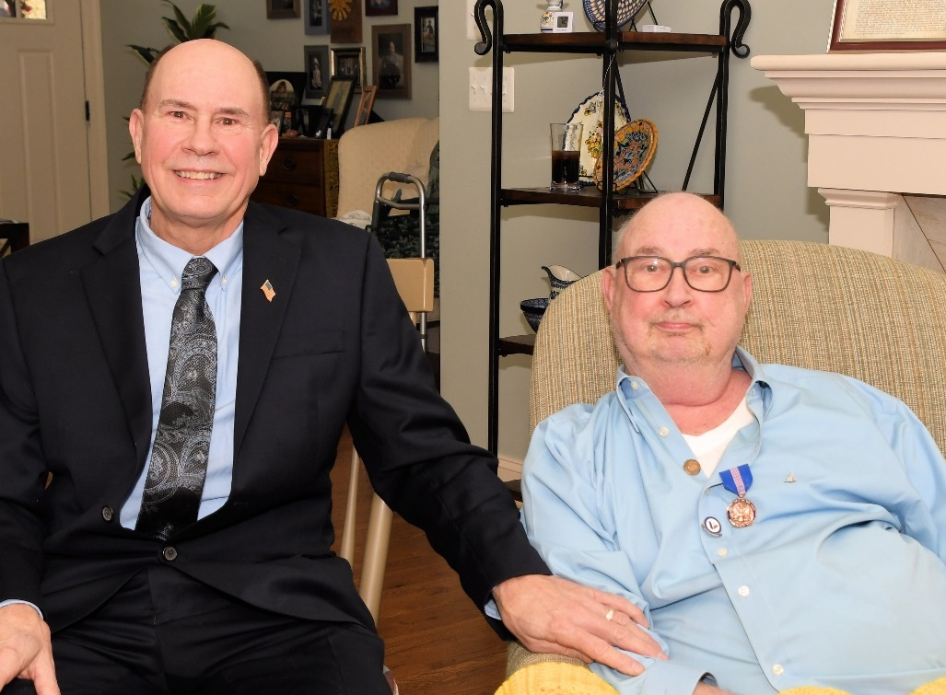
Our Mission
To provide counseling, support and care to anyone with serious illness, so they may live life to the fullest.
Our Vision
We are deeply committed to giving people the clear information and loving support they need to make informed choices about their care.
Our North Star
Be the undisputed leading provider of serious illness and end of life care in the mid-Atlantic region. We offer our community a wide range of patient and family centered services regardless of their ability to pay.

Slide 3
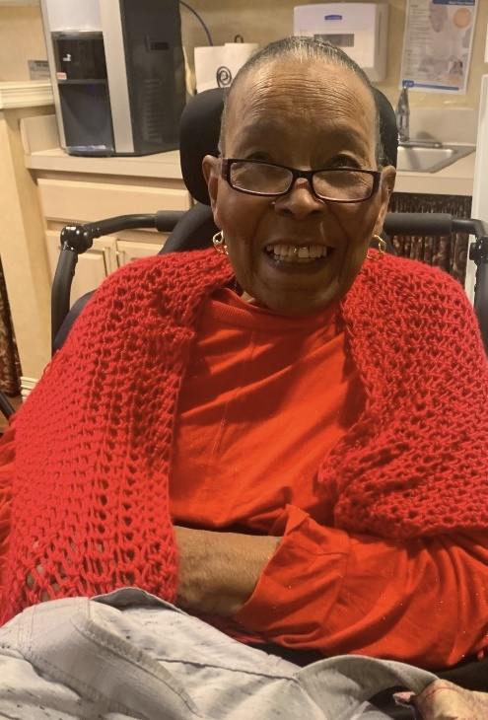

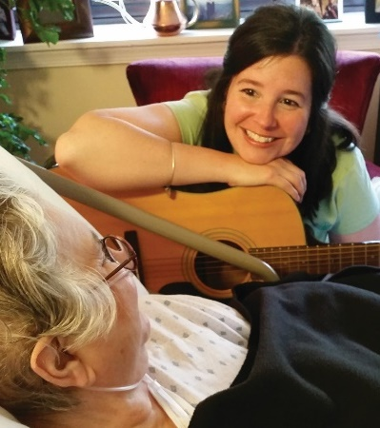
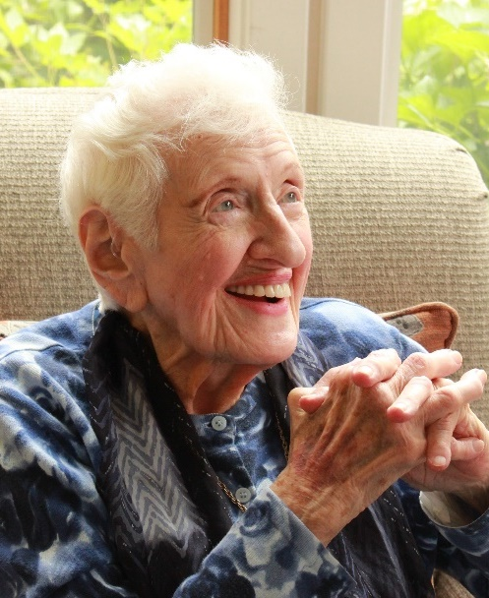

Gilchrist Programs and Services
Elder Medical Care
Counseling & Support and Special Programs
Primary Geriatric Home Care
(Home, Residential Community Care)
Palliative Consultations
Program for All-Inclusive Care for the Elderly (PACE)
Care Navigation
Volunteer Support
Jewish Care and Support
Music Therapy
Grief Counseling
We Honor Veterans
Community Education
Pet Therapy
Tanzania Hospice Partnership
Hospice Care
Home Care
Residential Community Care
Center Based Care
Gilchrist Kids
Hospice Care

Slide 4
Gilchrist Coverage Area
GARRETT
ALLEGANY
WASHINGTON
CARROLL
HARFORD
CECIL
Gilchrist Inpatient Centers
Baltimore County
Baltimore City
Howard County
FREDERICK
BALTIMORE
KENT
HOWARD
MONTGOMERY
ANNE
QUEEN
ARUNDEL
ANNE'S
PRINCE
TALBOT
GEORGE'S
CAROLINE
CALVERT
CHARLES
DORCHESTER
ST.
MARY'S
WICOMICO
WORCESTER
SOMERSET
Notes:
Cobranded slide
We are committed to serving the people of Baltimore. And not just Baltimore County, where our main campus is located, but Baltimore City, where we now have two outposts.

Slide 5
So, what does “hospice” really mean?
It is a model for quality, compassionate care for people facing a life-limiting illness or injury.
Focuses on medical care geared towards managing the symptoms of the disease rather than curing the disease itself
The core belief that each of us has the right to die pain-free and with dignity.
Focus is also on family/loved ones – providing spiritual and emotional care for the patient and family, as well as bereavement services as a family grieves the death of their loved one.

Slide 6

Where is hospice care provided?
Home Residence
Residential Care Community
  CCRC Communities
  Independent Living
  Assisted Living Facilities
  Nursing Homes
  Group Homes
Inpatient Hospice Center
  Involves specific criteria which must be approved by the hospice doctor. Involves symptoms that cannot be easily managed at your home, such as uncontrollable pain, agitation or nausea.
Notes:
Inpatient Care:
Involves specific criteria which has to be approved by the hospice doctor
Involves symptoms that cannot be easily managed at your home, such as uncontrollable pain, agitation or nausea

Slide 7
Our Goals
To receive care consistent with one’s beliefs, wishes and values.
To relieve suffering and improve quality of life.
And neither hastens, nor prolongs, the dying process.
To achieve life closure.
psychological
physical
social
spiritual
Notes:
Ed

Slide 8

Attending physician
Medical Director
Registered Nurse – Hospice Certification
Certified Hospice Aide
Social Worker
Chaplains
Volunteers
Licensed Bereavement Counselor
Music Therapist & Music Volunteers
Pet therapy
An Interdisciplinary Team Approach

Slide 9
How is Hospice different than Palliative Care?
Serious Illness Trajectory
Palliative Care
Curative Care
Hospice
Onset of
Serious Illness
Prognosis
<6 Months
Death and
Bereavement
Deliver aggressive symptom management
Provide anticipatory guidance about prognosis and course of disease
Work with patients to set treatment goals
Ensure smooth transitions of care across settings
Plan for end-of-life care and, for hospice patients, a peaceful death

Slide 10
The Bridge – Palliative Care
All Hospice Care is Palliative, BUT not all Palliative Care is Hospice.
Palliative Care
Any age, at any time of serious illness
Establish goals of care
Alongside treatments of cure, modification and maintenance
Place of residence, Outpatient clinic, Hospital settings
Medicare-part B
Concurrently with Rehab/SNF level care
Hospice Care
End of Life care
Expectation of less than 6 months
to live
Hospice provider and team
Place of residence, Inpatient Unit
Medicare- part A benefit
Cannot be offered alongside SNF
level care

Slide 11

The Bridge – Palliative Care
https://www.youtube.com/watch?v=lDHhg76tMHc

Slide 12

Hospice Care Eligibility
Under Medicare guidelines, eligibility requires a LIFE LIMITING ILLNESS with an expected prognosis of 6 MONTHS OR LESS
TWO PHYSICIANS must certify terminal illness
Notes:
Patient’s attending physician if they have one & Hospice Medical Director
NURSE PRACTICIONERS MAY NOT CERTIFY the patient

Slide 13

How is Hospice Care Paid For?
Medicare Part A
Managed Medicare
Medicaid
Commercial Insurance
Charitable Care
Notes:
Ed

Slide 14
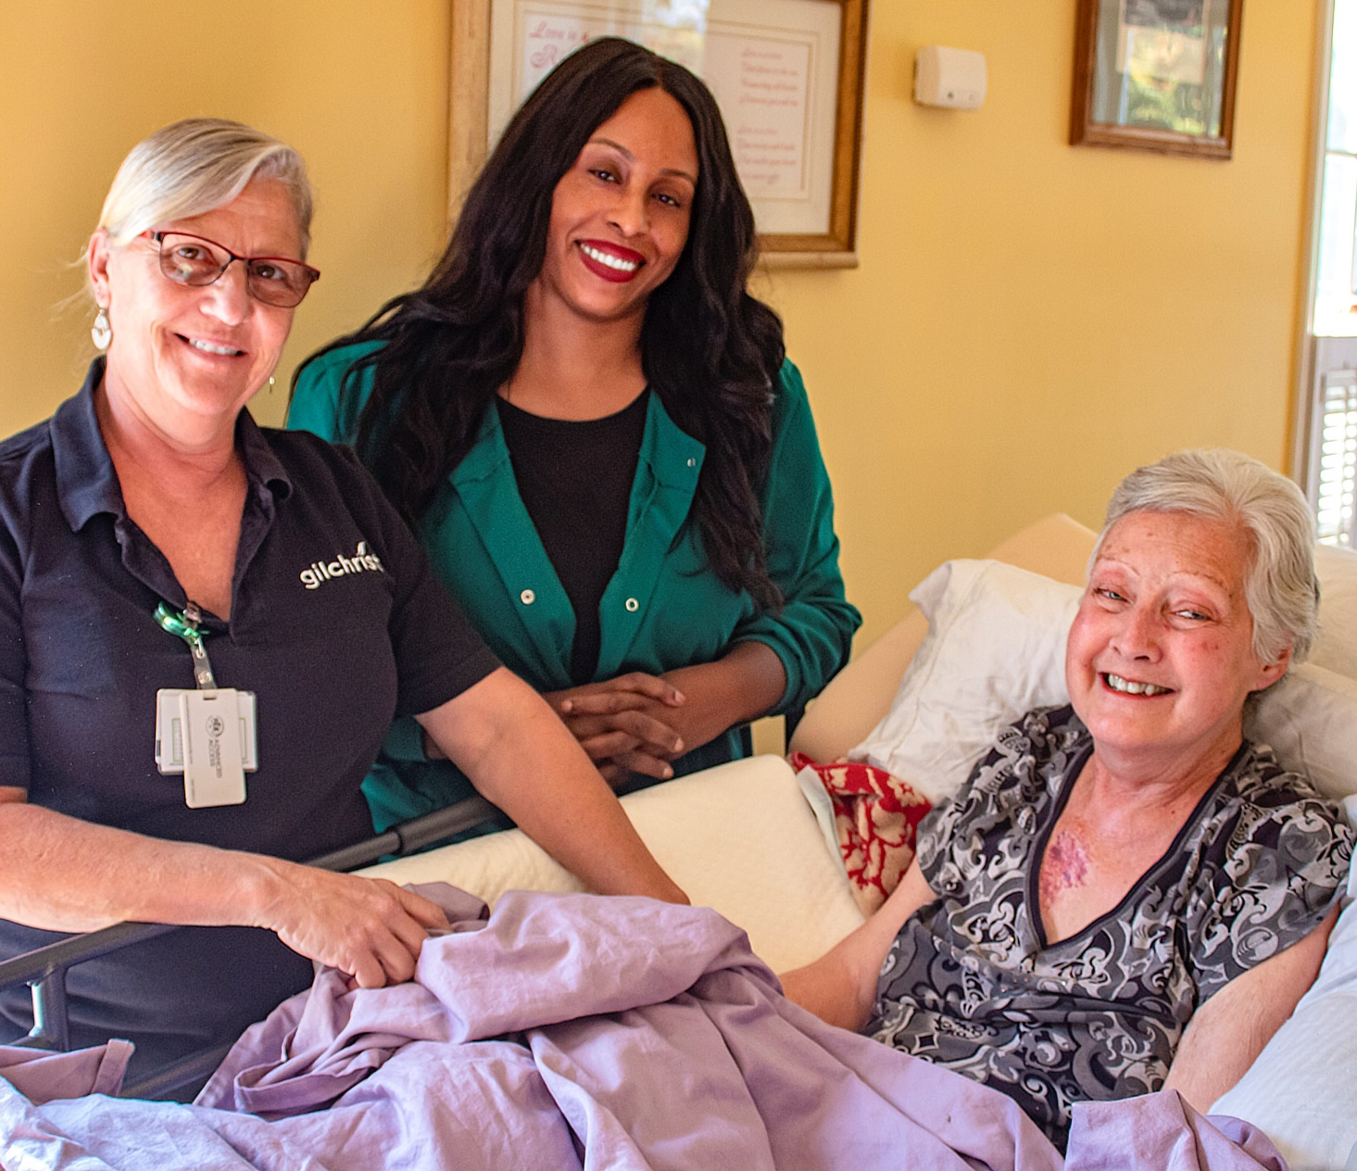
Services Provided through Hospice Care
Pain and Symptom Management
Medication related to the terminal diagnosis
Equipment & supplies related to the terminal diagnosis
Spiritual Care
Hospice Aides
Volunteers
Inpatient and respite stay
Bereavement counseling
Complementary support services

Slide 15
Seven Values

Slide 16

Can I change my mind?
An individual can revoke the election of hospice care at any time.
  Revocation must be in writing and not verbal.
Only an individual can revoke the hospice benefit.
Reasons for revocation:
  Patient/family desire curative care

Slide 17
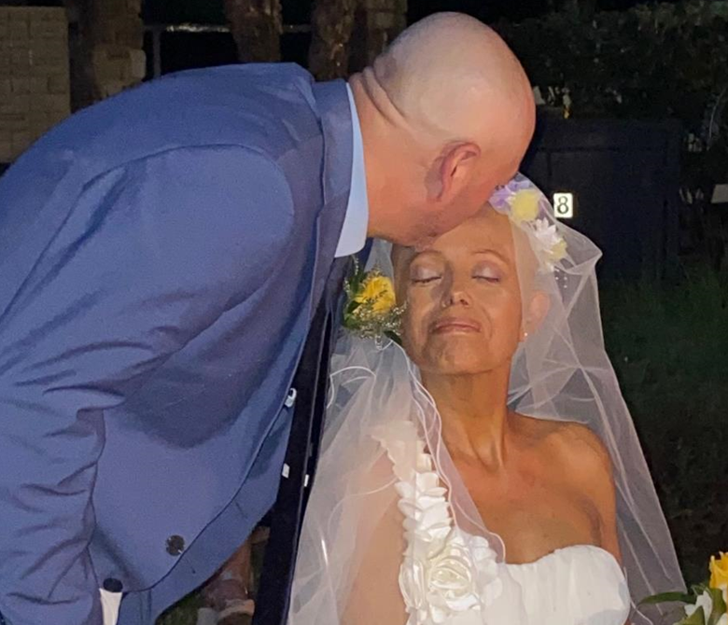
Why are Early Referrals Important?
Gilchrist’s Most Frequent Family Feedback:
“I wish we
knew about you sooner.”
Notes:
May prevent symptom and pain management problems
Provides time to build rapport and trust with the team
Provides time for the team to teach family and help them with decision making and planning
Addresses anticipatory grief and loss issues
Enables patient to enjoy life to the fullest extent possible
Shifts the focus from treatment to comfort and symptom relief
Addresses the spiritual and psychological issues to help patients find meaning and acceptance at the end of life

Slide 18
Why are Early Referrals Important?
Enables patient to enjoy life to the fullest extent possible
Shifts the focus from treatment to comfort and symptom relief
Addresses the spiritual and psychological issues to help patients find meaning and acceptance at the end of life
Time to discuss and support end-of-life care planning
Addresses anticipatory grief and loss issues

Slide 19
When to Call
Rapid health decline
Frequent hospitalizations or trips to the ER
Signs of increasing illness
Decision to focus on quality of life over aggressive treatment
Difficulty completing daily activities

Slide 20
Myth vs. Reality
Myth: Hospice is a “place.”
Fact: Hospice can be provided any place you call home.
Myth: Hospice care is just for the elderly.
Fact: Hospice care is provided to people of all ages, from infancy to adulthood.
Myth: Choosing Hospice means I only have days or hours to live.
Fact: Hospice care is for people who have decided to focus on their comfort and quality of life and who may have an expected prognosis of 6 months or less to live.
Myth: Medicare requires a patient be DNR (Do Not Resuscitate).
Fact: This is false. Hospice can be provided for those who wish to have CPR.

Slide 21
Myth vs. Reality
Myth: Hospice care manages pain by only using addictive narcotics.
Fact: Hospice utilizes many methods to manage pain and other symptoms.
Myth: Hospice will starve me and stop all my medications.
Fact: Patients can eat and drink whatever they want if they are able to. Medications are reviewed with patient and family on an ongoing basis to ensure they are in line with comfort and improving one's quality of life.
Myth: Only individuals with money have access to hospice care.
Fact: Hospice is provided regardless of one’s ability to pay. Most commercial insurances, Medicare/Medicaid pay for hospice; however, if an individual is un-insured or under insured – Gilchrist will work with the individual to ensure services are provided.
Notes:
Cathy

Slide 22
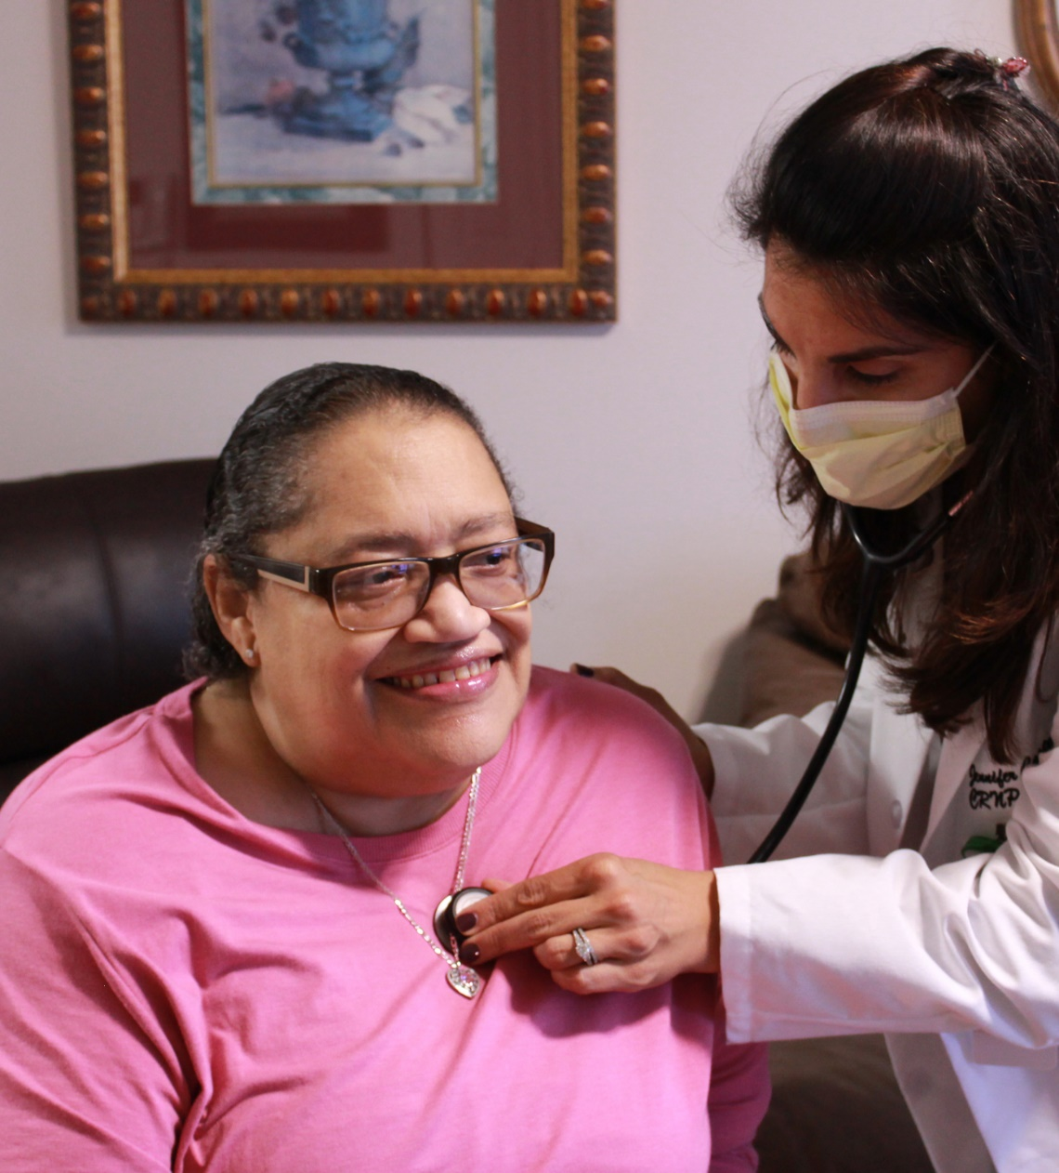
Specialized Geriatric Services
Elder Medical Care at Home
A team led by Gilchrist Geriatricians and Nurse Practitioners provide home visits to seniors with chronic disease who aren't yet eligible for hospice.

Slide 23
Elder Medical Care at Home
The Critical Need for Home-Based Primary Care Services for Seniors
Provides primary care for older adults with serious illness to prevent hospitalization, improve quality of life and help frail seniors age in place safely in their homes well before hospice is needed.
Patients are eligible for the program if they are homebound adults, over the age of 55 with three chronic conditions OR
With one chronic condition and a diagnosis of Dementia.

Slide 24



Jewish Care and Support Program
Care with special considerations of Jewish customs, rituals and laws.
Spiritual support available from a team of Rabbis, in addition to Gilchrist chaplains
Mezuzot and Jewish ritual objects available at all Gilchrist Care Centers; kosher food available upon request
Specialized support program for Holocaust survivors and their families
Grief services, including one-on-one counseling and support groups, offered both through Gilchrist and in collaboration with Jewish Community Services, an agency of The Associated
Holiday programs at RCCs throughout our service area as well as patients’ homes
Shalom Calls
Gilchrist Center Towson has a beautiful Jewish Meditation room with siddurim (prayer books), a ner tamid, and a Jerusalem Wall that mimics the Kotel
Accredited by the National Institute for Jewish Hospice
Ambassador (educational) events at local synagogues and Jewish organizations

Slide 25



Program components
3 PRN Rabbis that provide support to Jewish patients and their families as well as on-call coverage

Slide 26
Thank you!
Any Questions?

